Slide 1
MA3077 (DLI) Operational Research Lecture 9 – Networks
Dr Marco Fasondini

Slide 2
Recapitulation and lecture outline
Summary: We have learnt:
about sensitivity analysis
how to model mixed-integer linear programming problems,
and how to solve them in Matlab using intlinprog.
Today: Networks, following loosely Ch. 10 of the book by Hillier and Lieberman.

Slide 3
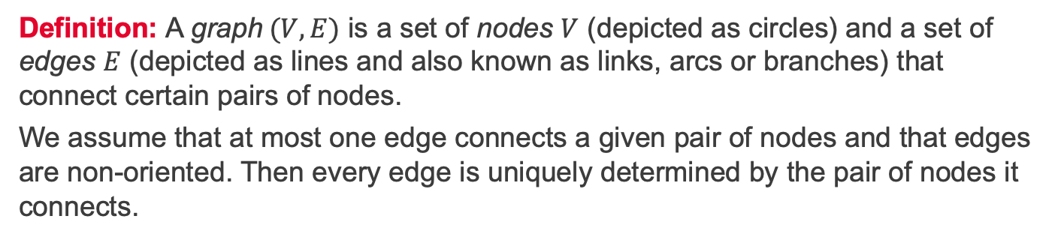
Graphs, nodes, and edges
A
T
B
D
O
C
E
Definition: A graph$(V,E)$ is a set of nodes $V$ (depicted as circles) and a set of edges $E$ (depicted as lines and also known as links, arcs or branches) that connect certain pairs of nodes.
We assume that at most one edge connects a given pair of nodes and that edges are non-oriented. Then every edge is uniquely determined by the pair of nodes it connects.

Slide 4
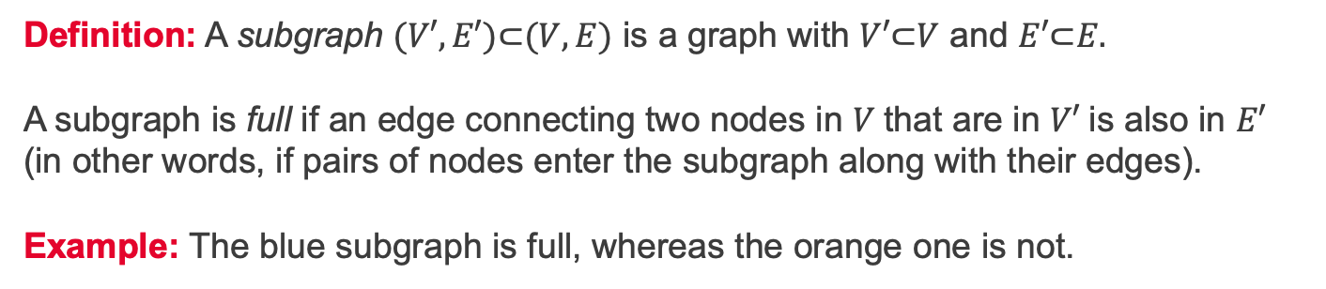
Subgraphs and full subgraphs
A
T
B
D
O
C
E
Definition: A subgraph $(V′,E′)\text{⊂}(V,E)$ is a graph with $V′\text{⊂}V$ and $E′\text{⊂}E.$ A subgraph is full if an edge connecting two nodes in $V$that are in $V′$is also in $E′$ (in other words, if pairs of nodes enter the subgraph along with their edges). Example: The blue subgraph is full, whereas the orange one is not.

Slide 5
Paths and cycles
A
T
B
D
O
C
E
Definitions:
Two edges are connected if adjacent to a common node
A path is a (unique) sequence of connected edges with each node being adjacent to at most two edges in the path (e.g. blue line)
A cycle is a path that begins and ends at the same node (e.g. orange line).

Slide 6
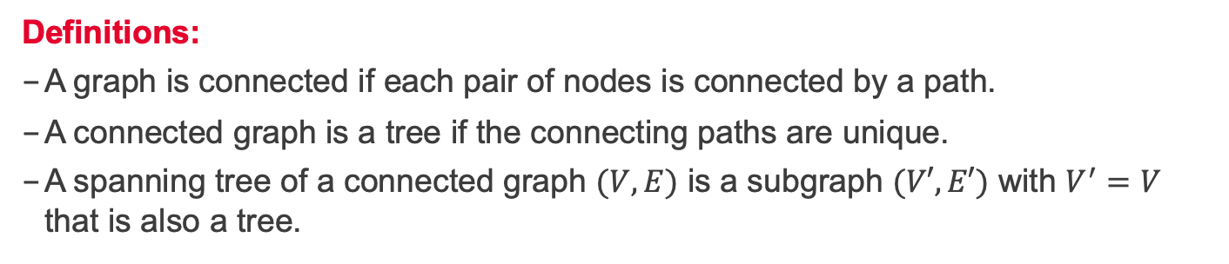
Connected graphs and trees
A
T
B
D
O
C
E
Definitions:
A graph is connected if each pair of nodes is connected by a path.
A connected graph is a tree if the connecting paths are unique.
A spanning tree of a connected graph $(V,E)$ is a subgraph $(V′,E′)$ with $V^{′}=V$ that is also a tree.

Slide 7
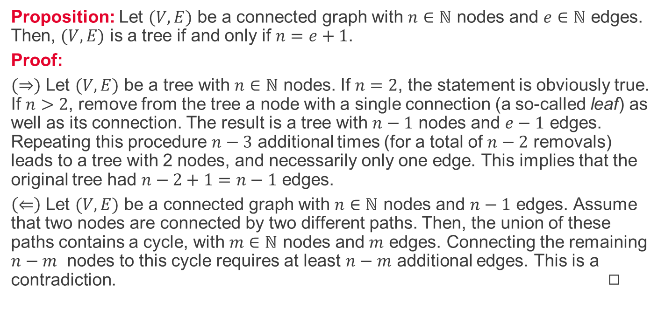
Euler formula for trees
Proposition: Let $(V,E)$ be a connected graph with $n∈ℕ$ nodes and $e∈ℕ$ edges. Then, $(V,E)$ is a tree if and only if $n=e+1$.
Proof:
$(⇒)$ Let $(V,E)$ be a tree with $n∈ℕ$ nodes. If $n=2$, the statement is obviously true. If $n>2$, remove from the tree a node with a single connection (a so-called leaf) as well as its connection. The result is a tree with $n−1$ nodes and $e−1$ edges. Repeating this procedure $n−3$ additional times (for a total of $n−2$ removals) leads to a tree with 2 nodes, and necessarily only one edge. This implies that the original tree had $n−2+1=n−1$ edges.
$\left(⇐\right)$ Let $(V,E)$ be a connected graph with $n∈ℕ$ nodes and $n−1$ edges. Assume that two nodes are connected by two different paths. Then, the union of these paths contains a cycle, with $m∈ℕ$ nodes and $m$ edges. Connecting the remaining $n−m$ nodes to this cycle requires at least $n−m$ additional edges. This is a contradiction. ◻︎

Slide 8
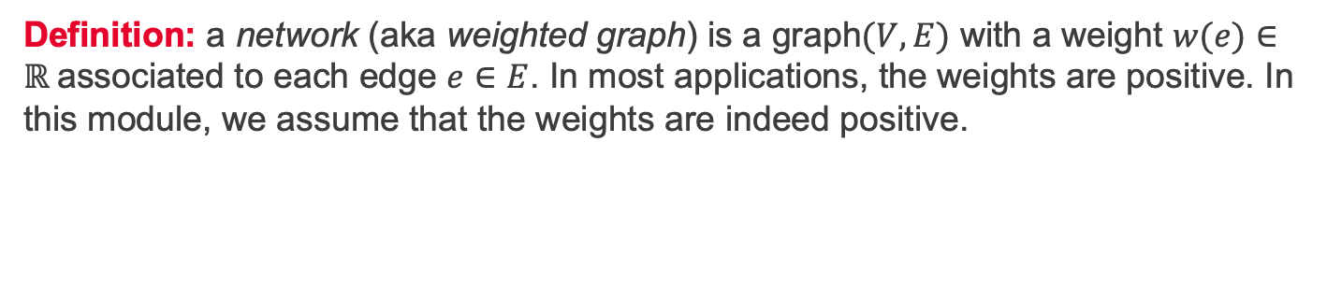
Networks
A
7
2
2
5
T
5
4
B
D
O
1
1
3
7
4
C
3
E
Definition: a network (aka weighted graph) is a graph$(V,E)$ with a weight $w(e)∈ℝ$associated to each edge $e∈E$. In most applications, the weights are positive. In this module, we assume that the weights are indeed positive.

Slide 9
Example of a network - scenario
A
7
2
2
5
T
5
4
B
D
O
1
1
3
7
4
C
3
E
Scenario: A park has a narrow, winding road system for trams (shown in the figure). Location O is the entrance into the park; other letters designate the locations of ranger stations (and other limited facilities). The numbers are lengths of roads in miles. The park contains a scenic wonder at station T. A small number of trams are used to transport sightseers from the park entrance to station T and back.

Slide 10
Example of a network – typical problems
A
7
2
2
5
T
5
4
B
D
O
1
1
3
7
4
C
3
E
Problem 1: The park manager wants to install telephone lines under the roads to establish telephone communication among all the stations. To reduce costs, lines will be installed under just enough roads to ensure every station is connected to the web. Where shall they lay the lines to minimise the total length of lines installed?
Problem 2: What is the shortest route from the entrance to the scenic station T?

Slide 11
Minimal spanning trees and shortest paths
A
7
2
2
5
T
5
4
B
D
O
1
1
3
7
4
C
3
E
Minimal spanning tree problem: Identify a connected subnetwork that contains all the nodes and such that the sum of the weights of the edges included (the total weight) is minimal.
Shortest path problem: Determine a path to join two nodes such that the sum of the weights of the edges included is minimal.

